Slide 1


Analyzing the Correlation Between Air Quality (PM2.5 and NO2) Data and Public Health Outcomes (Asthma) in New York City
By: Marzieh Rasti
Data Science Capstone Project

Slide 2
The Problem
Relationship between air quality and respiratory problems, specifically asthma-related hospital visits, in New York City.
Research Questions:
How are NO2 and PM2.5 levels correlated with the number of hospital visits due to asthma?
How do pollutants levels vary across different GeoTypes in New York City?
Can we develop a predictive model to forecast the number of asthma-related hospital visits based on NO2 and PM2.5 levels?

Slide 3
Stakeholders
New York City Residents
Stakeholders
Environmental Agencies
Local health Authorities

Slide 4
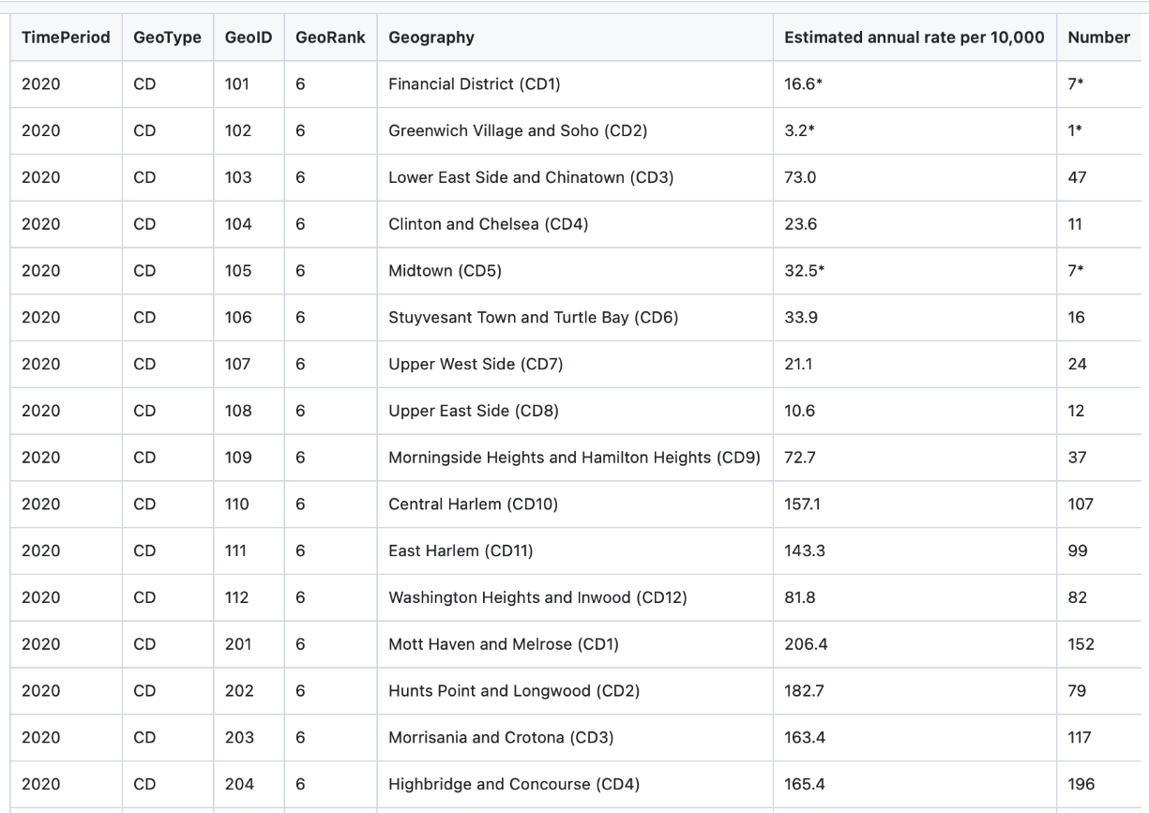
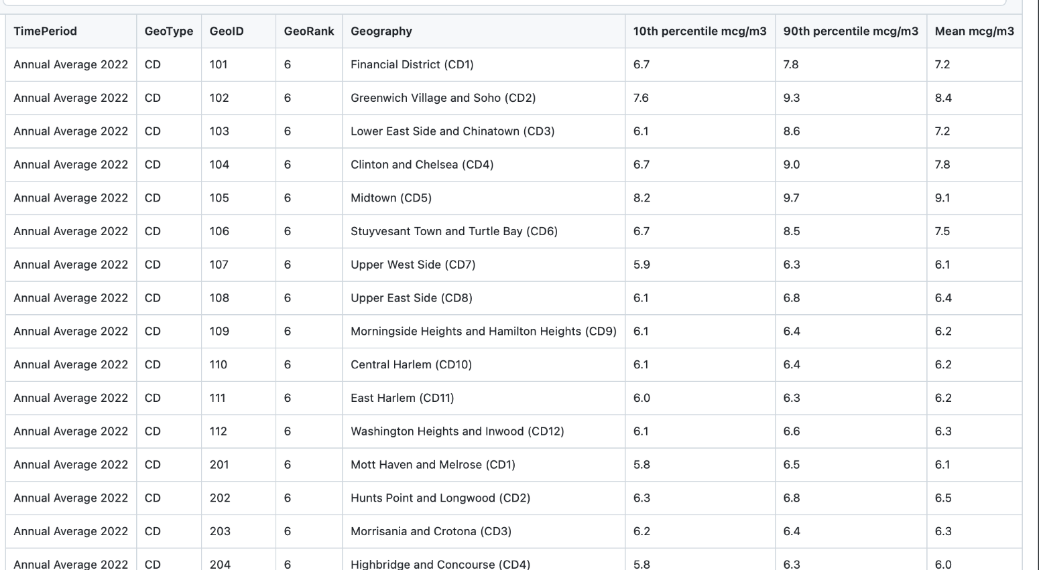
Data
Data Source: https://a816-dohbesp.nyc.gov/IndicatorPublic/data-explorer/air-quality/?id=2023#display=summary

Slide 5
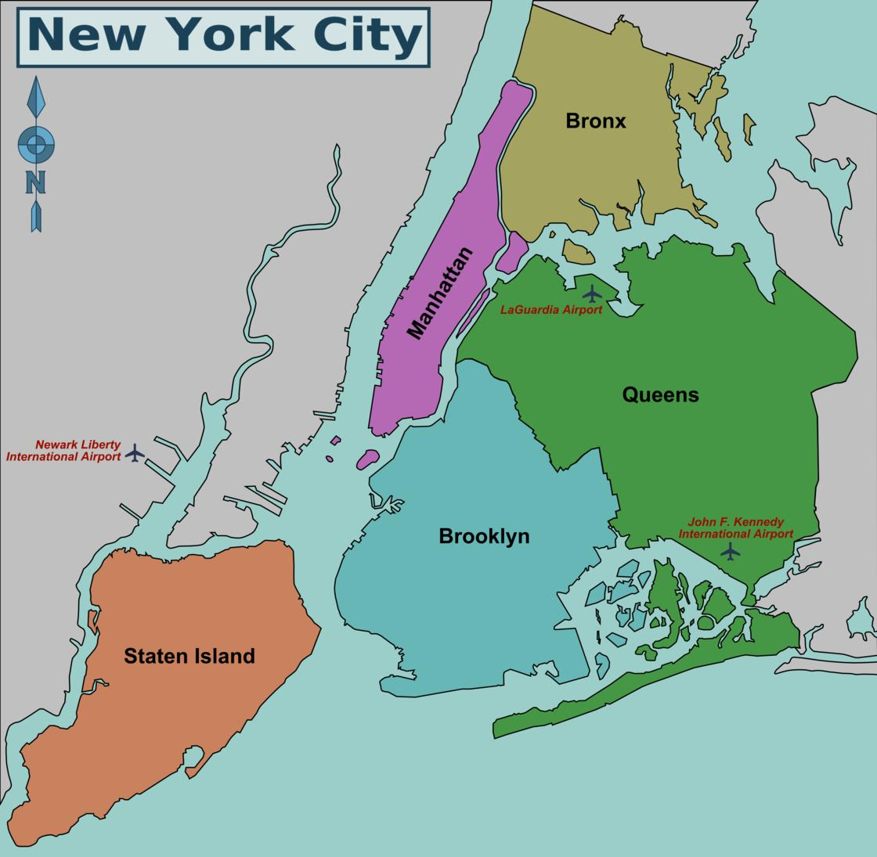
Data Collection Areas(New York City Boroughs)

Slide 6
Data Wrangling
Original dataset had 2,037,616 rows and 18 columns
Drop columns that were based on an unclear measuring method
To ensure consistency, the yearly records chosen and discarded the seasonal data
The dataset does not have any null values
Drop some geographical columns did not contain any useful information
Target Value: Number of Adult Asthma

Slide 7
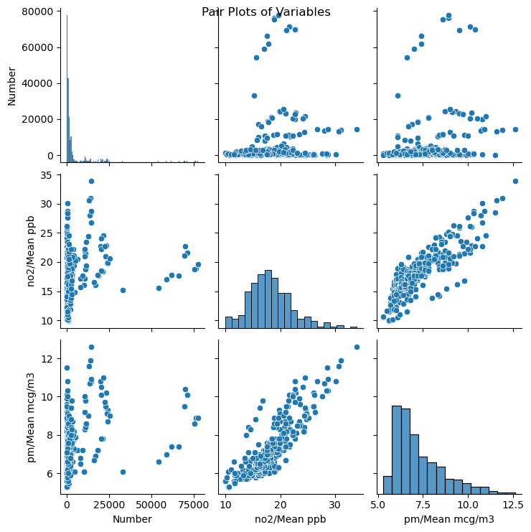
Exploratory Data Analysis
Pairwise relationships in the dataset

Slide 8
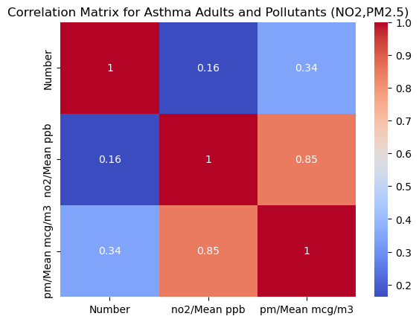
Correlation between different features in the dataset

Slide 9
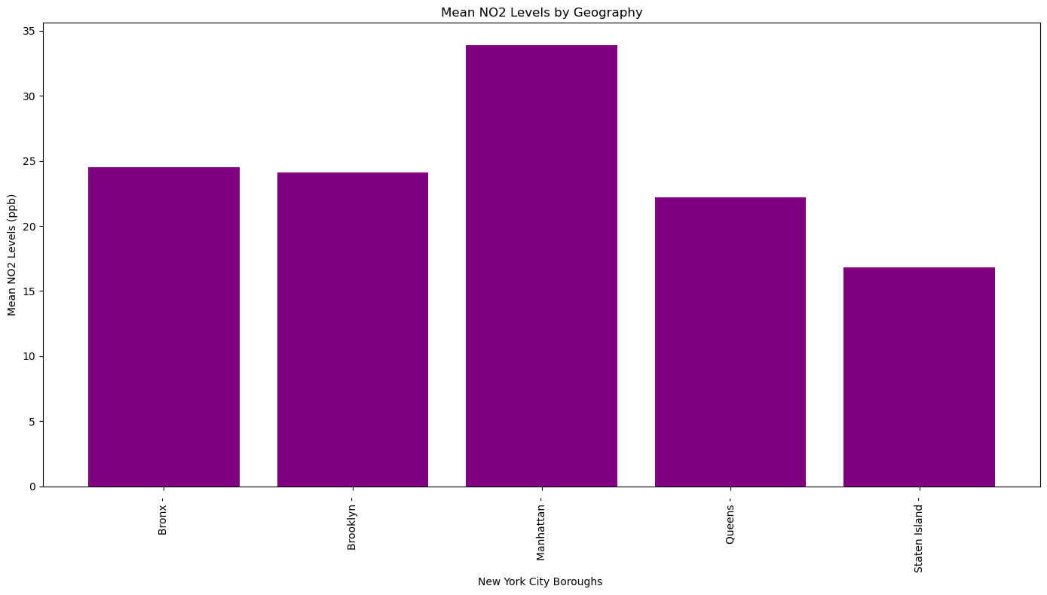
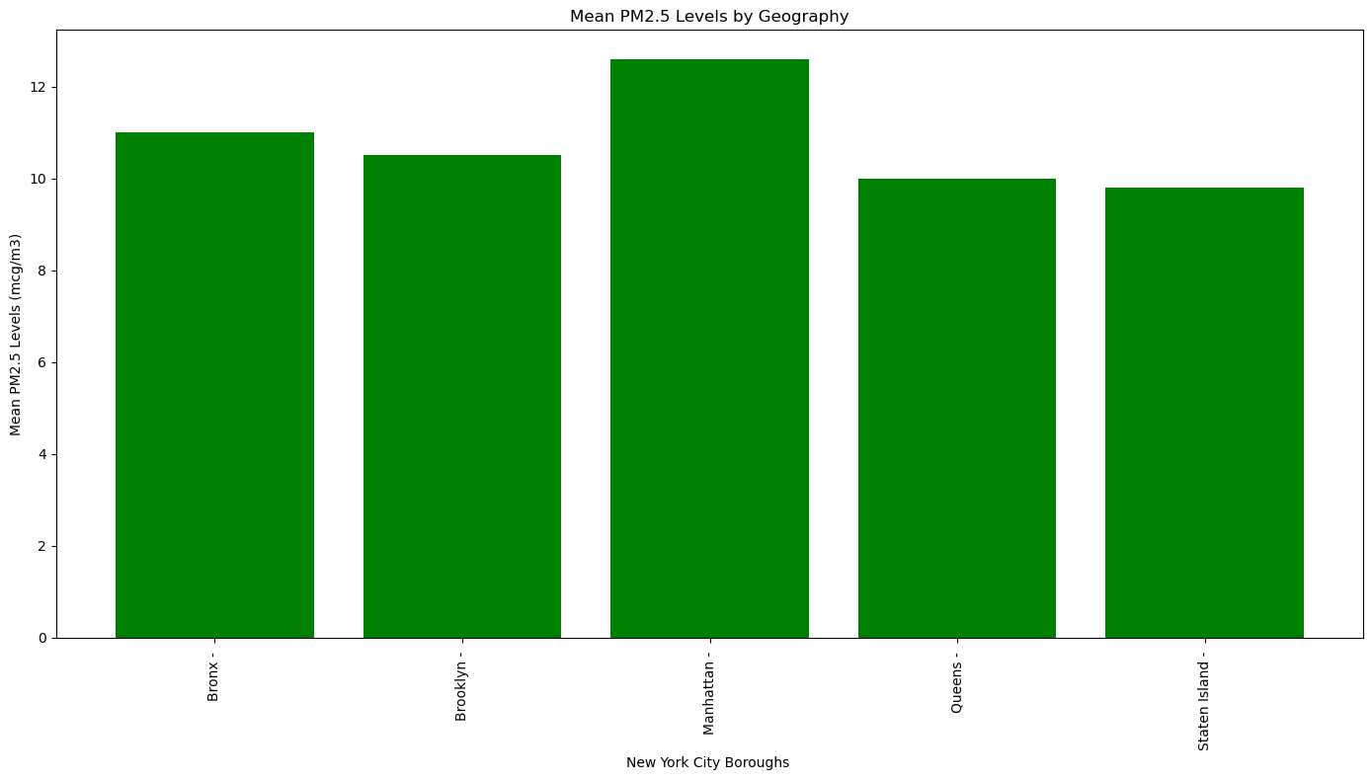
Geographical Distribution of Pollutants Levels&Asthma
Geographical Distribution of Mean NO2 Levels in NYC Boroughs
Geographical Distribution of Mean PM 2.5 Levels in NYC Boroughs

Slide 10
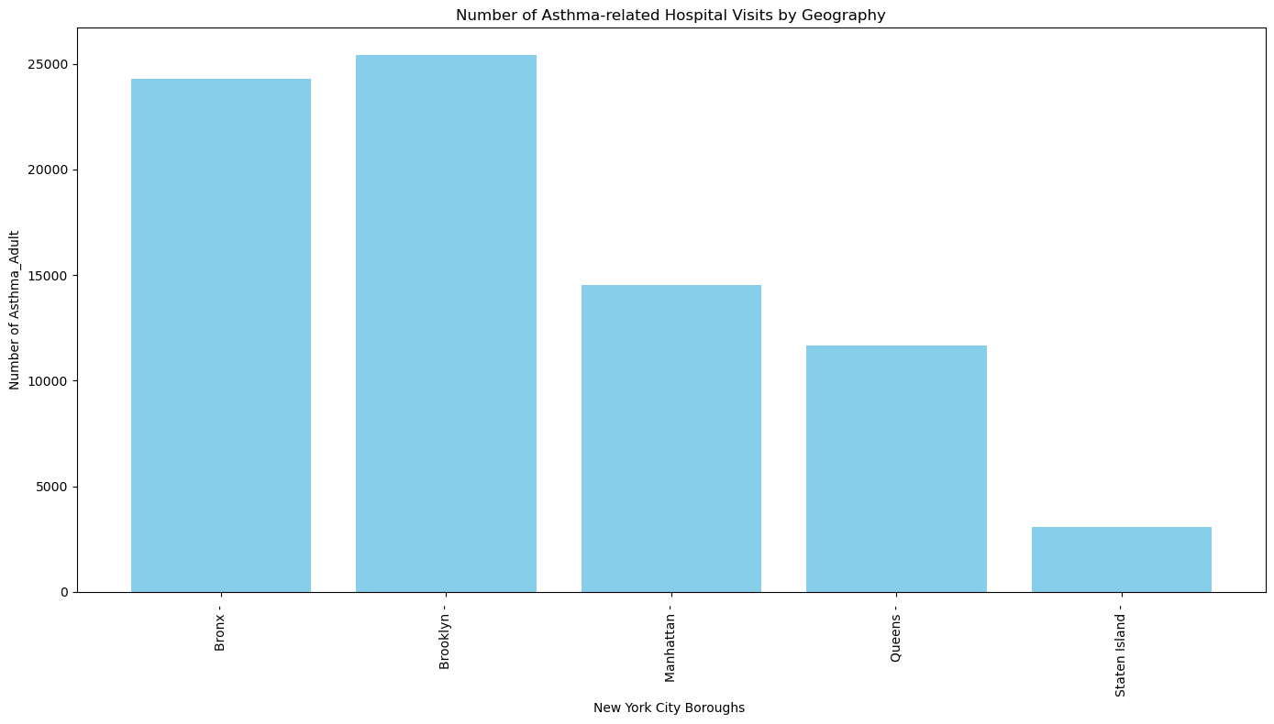
Figure 5: Geographical Distribution of the Number of Asthma-related Hospital Visits in NYC Boroughs

Slide 11
Machine Learning Modeling
Type: Supervised Learning
Multiple Linear Regression
Ridge Regression (Regularized Linear Regression)
Gradient Boosting Machines
Random Forest
Support Vector Regression Model(SVR)

Slide 12
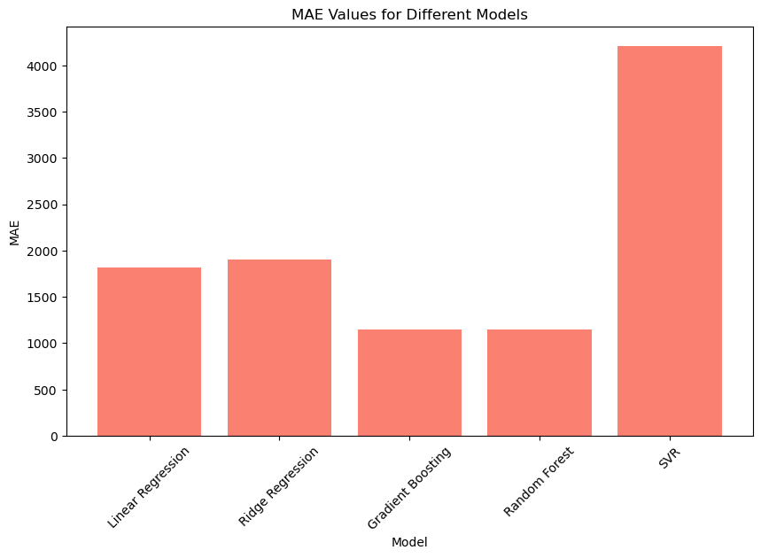
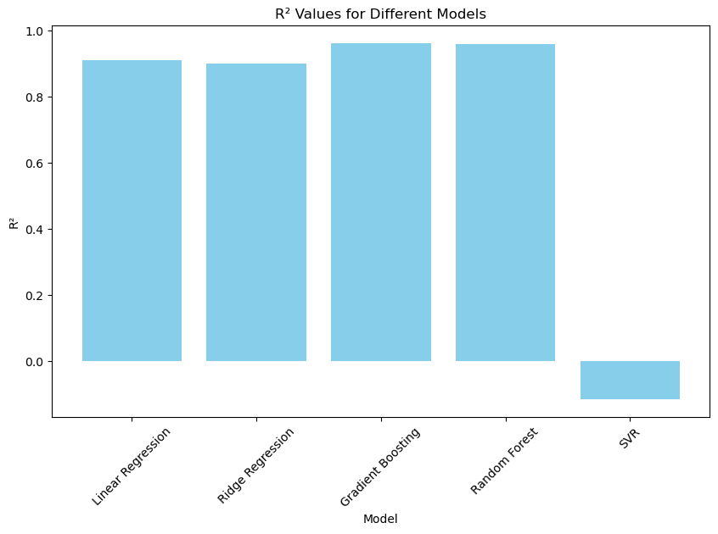
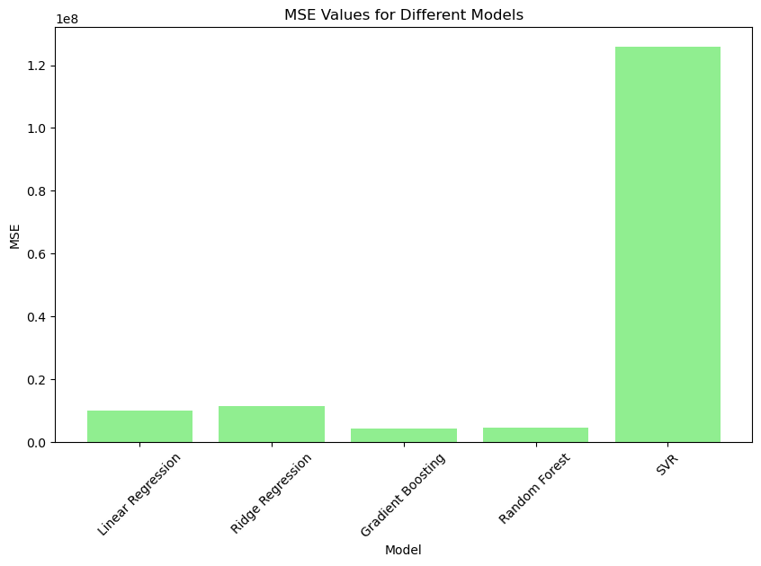
Comparison Models

Slide 13
Comparison and Model Selection
Model | R2 | MAE | MSE
Linear Regression | 0.910860 | 1820.996477 | 1.005953e+07
Ridge Regression | 0.899823 | 1906.950252 | 1.130502e+07
Gradient Boosting | 0.963038 | 1142.768278 | 4.171197e+06
Random Forest | 0.960578 | 1145.995271 | 4.448820e+06
SVR | -0.115649 | 4208.299780 | 1.259013e+08
SVR model is the worst, Random Forest and Gradient Boosting are the best models

Slide 14
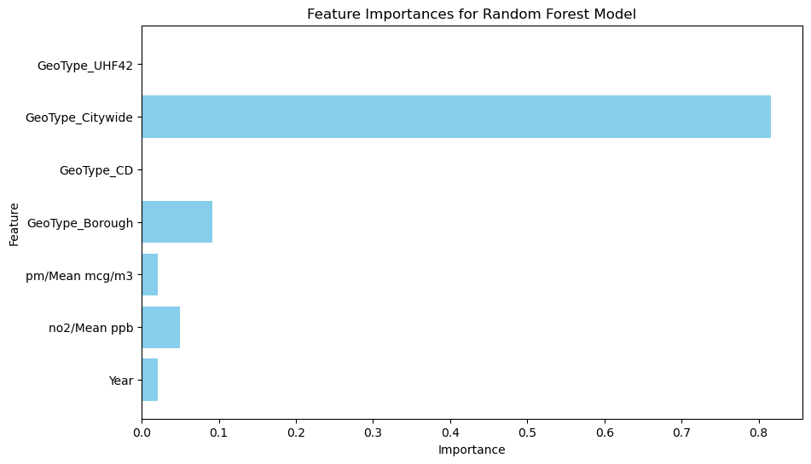
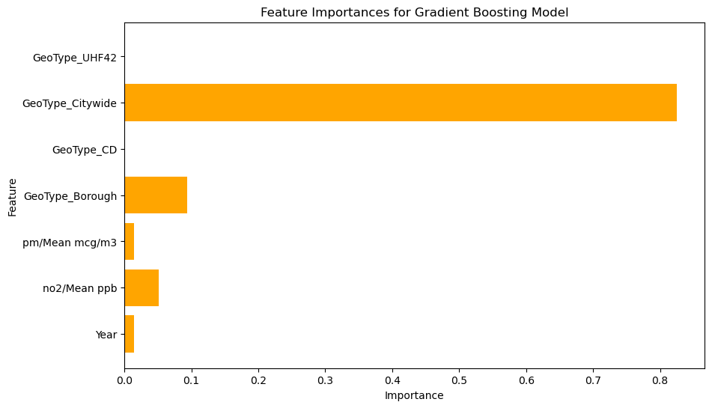
Feature importances for Selected Models

Slide 15
Applying Grid search CV for hyperparameter Tuning
Table 1: Results of the performance metrics for two machine learning models
Model | Best Score | Test Score | R2
Random Forest | 0.945868 | 0.954561 | 0.954561
Gradient Boosting | 0.950065 | 0.944047 | 0.944047

Slide 16
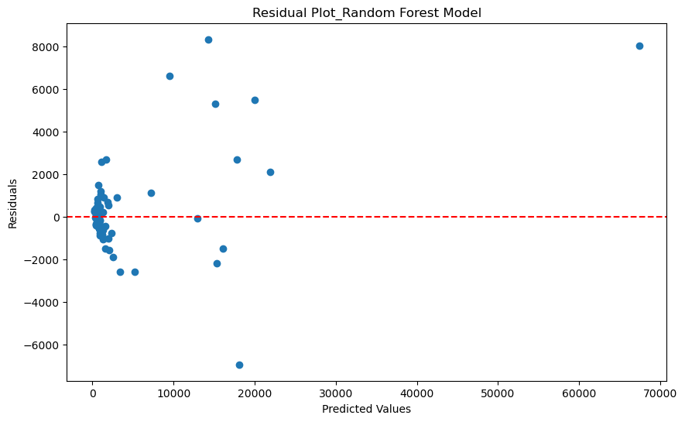
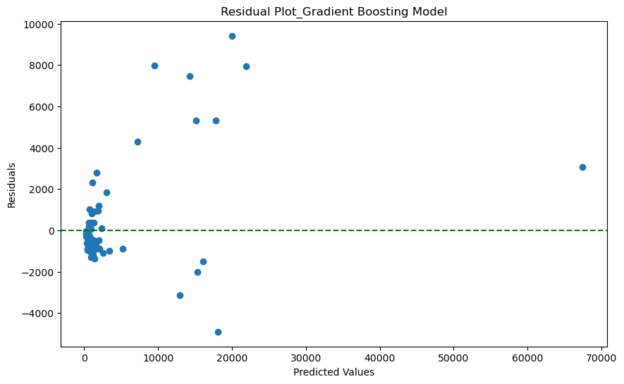
Differences between the actual and predicted values

Slide 17
Conclusion
In this modeling project, multiple machine learning algorithms were applied to predict asthma-related hospital visits in New York City based on various air quality and geographical features. The models evaluated include Linear Regression, Ridge Regression, Gradient Boosting, Random Forest, and Support Vector Regression (SVR).
The performance metrics (R2, MAE, and MSE) showed that both Gradient Boosting and Random Forest performed exceptionally well, with R2 values of 0.962973 and 0.960578, respectively. These models also demonstrated lower MAE and MSE values compared to the other models, indicating better prediction accuracy and precision.
The feature importance plots revealed that geographical features, particularly GeoType_Citywide, had the most significant impact on the predictions, followed by air quality metrics such as pm/Mean mcg/m3 and no2/Mean ppb.
Hyperparameter tuning using Grid Search CV was performed to optimize the models. For Random Forest, the best parameters included max_depth: 10, max_features: 'sqrt', and n_estimators: 200. For Gradient Boosting, the optimal parameters included learning_rate: 0.1, max_depth: 5, and n_estimators: 100.
Residual plots indicated that while the models performed well, there are still some outliers.

Slide 18
Future Overseeing
Further explore and engineer features that could improve model performance, such as incorporating additional air quality metrics or socioeconomic factors.
Collect more data, especially from air pollutants, different time periods or additional geographical areas, to improve model generalization.
Explore advanced algorithms such as XGBoost, LightGBM, or neural networks to potentially capture complex relationships within the data.
Investigating the temporal dynamics of air quality and asthma exacerbations by incorporating time-series analysis could reveal seasonal or temporal trends that are not captured by static models. This could help in understanding how different times of the year or specific weather conditions affect asthma incidence.
Conducting more detailed geospatial analysis using advanced GIS tools could help in identifying specific areas within the city that are more prone to poor air quality and higher asthma rates. This could inform targeted interventions and policy decisions.

Slide 19
Thank You!

